Slide 1
Analyzing UPI Transaction Growth in India
A Data-Driven Approach to Understanding Trends and Forecasts

Slide 2
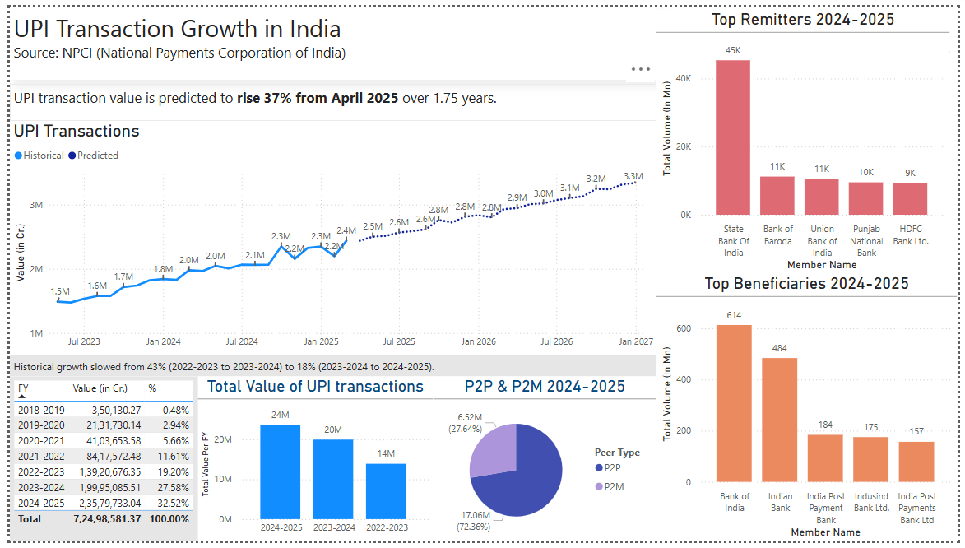
Task: Create a dashboard that explores the growth of UPI transactions in India, focusing on volume, value, and key performers.

Slide 3
Nature of NPCI Data and Added Metrics
Transaction volume (Mn) and value (Cr)
Focus: Monthly metrics, P2P and P2M, and top performers - remitters/beneficiaries.
Monthly and yearly trends for granular insights into UPI adoption.

Slide 4
Forecasting UPI Growth Using Prophet
Prophet - a time-series forecasting model by Meta, for predictions.
Handles seasonality and trends effectively,
UPI’s cyclical data.

Slide 5
Insights and predictions
UPI transaction value hit 24M Cr in 2024-2025, P2M dominating at 72.36%.
Forecasts predict a 37% rise by April 2026, reaching 3.32M Cr by Jan 2027.
Monthly peaks like 3.34M Cr in October 2024 (latest)
Top performers like Bank of Baroda (1,223.77 Mn) - strategic partnerships.

Slide 6
Prospects for Enhanced Analysis
Sector-wise data to identify high-growth industries using UPI.
Financial metrics (e.g., BD%, TB%, Deemed%) for top performers and apps.
Comparison with other payment methods using RBI data.

Slide 7
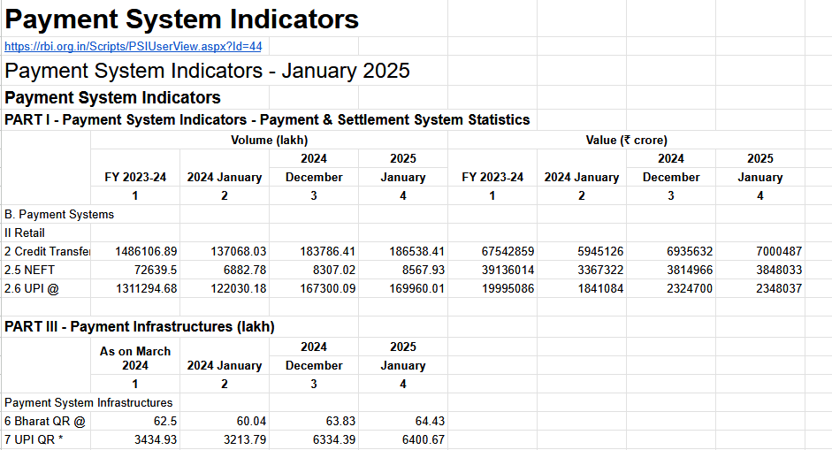
Annex: RBI

Slide 8
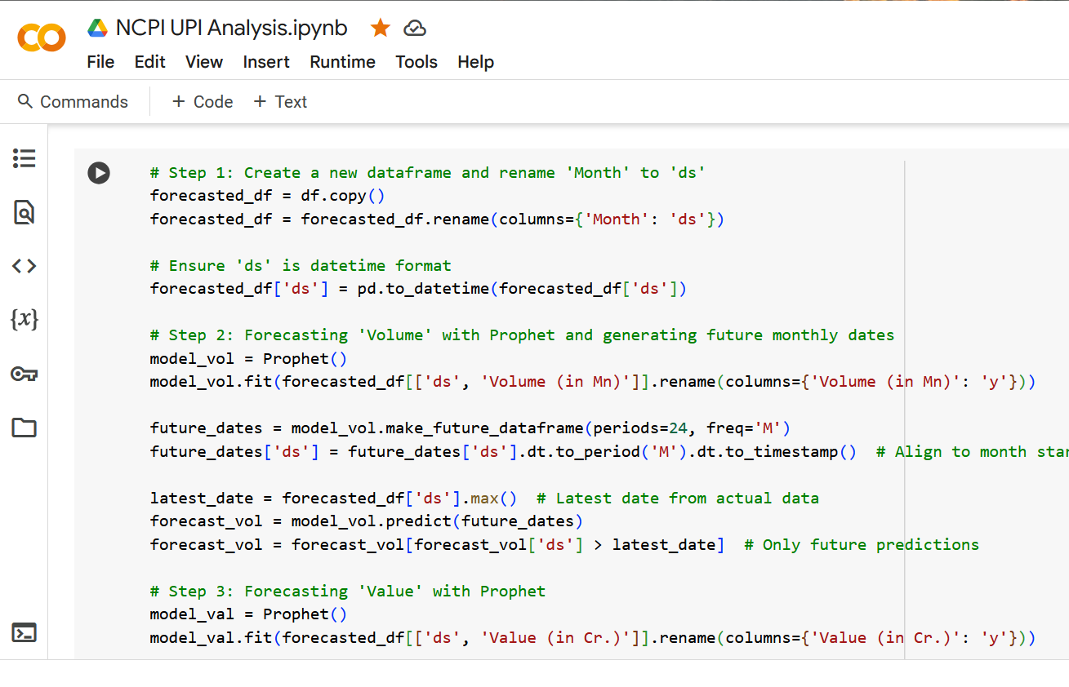
Annex: Analysis

Slide 9
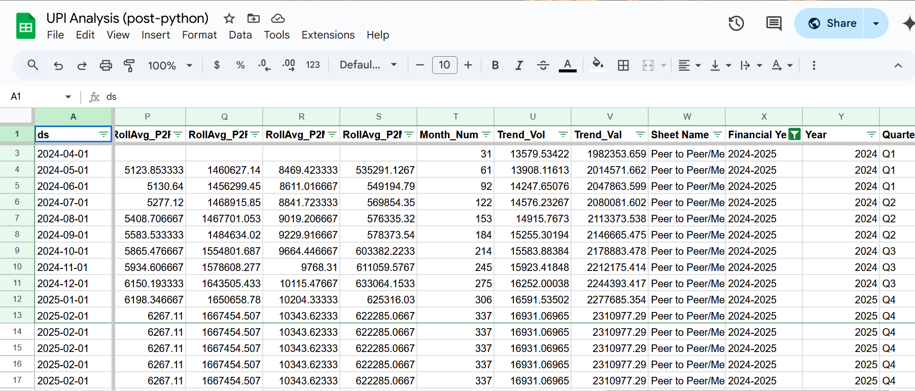
Annex: Post analysis

